Slide 1







Analysis on Emerging Technology Skills and Trends
Abdulmajeed Yusuf
April 10th 2023

Slide 2



OUTLINE
Executive Summary
Introduction
Methodology
Results
Visualization – Charts
Dashboard
Discussion
Findings & Implications
Conclusion
Appendix

Slide 3

EXECUTIVE SUMMARY
Current Usage Trends
Languages
Web Frames
Platforms
Gender Disparities in Tech
Trends
Demographics

Slide 4

INTRODUCTION
Survey of Digital Usage Trends
Conducted by GitHub
Recommendations will be stated based on the analysis

Slide 5

METHODOLOGY
Virtual survey of volunteer users
Data cleaning and normalization
Analysis of cleaned data
Visualizations
Current Trends
Future Trends

Slide 6
RESULTS

Slide 7
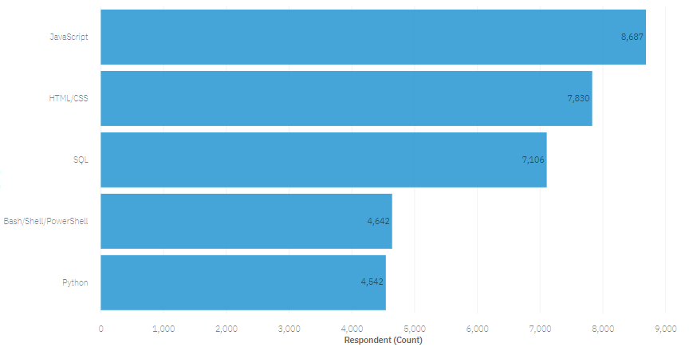
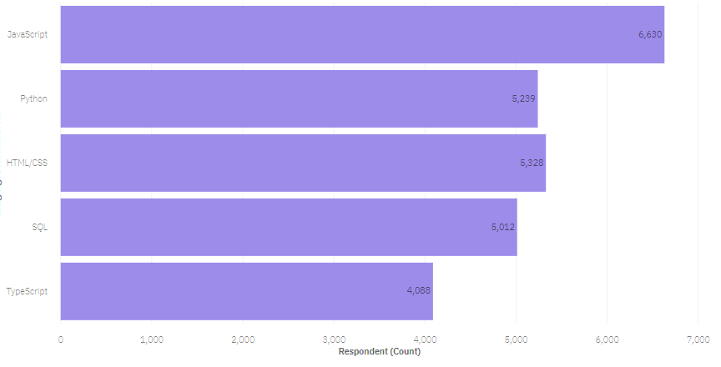
PROGRAMMING LANGUAGE TRENDS
Current Year
Next Year

Slide 8
PROGRAMMING LANGUAGE TRENDS - FINDINGS & IMPLICATIONS
Findings
JavaScript and HTML/CSS continue to be the top two most popular programming language for this year and next
Python and TypeScript will gain more interest for next year
Interest in SQL and Bash/Shell/PowerShell is decreasing
Implications
Continue to employ a similar number of people skilled in JavaScript and HTML/CSS
More people skilled in Python and TypeScript gain more employment
SQL and Bash/Shell/PowerShell have less job openings

Slide 9
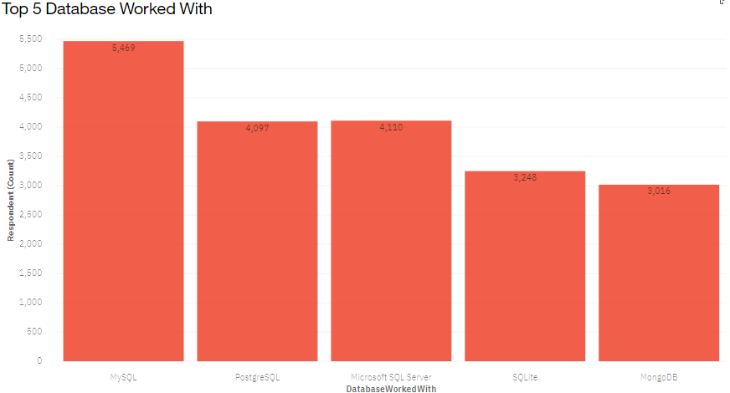
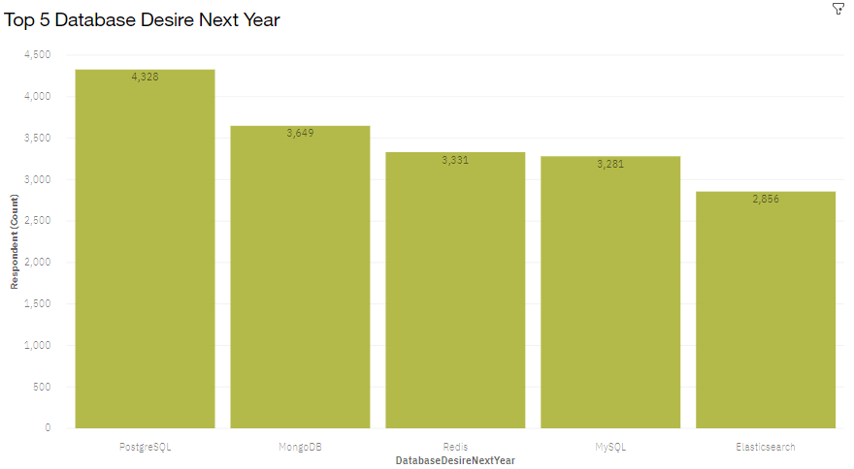
DATABASE TRENDS
Current Year
Next Year

Slide 10
DATABASE TRENDS - FINDINGS & IMPLICATIONS
Findings
Interest in MySQL, Microsoft SQL Server and SQLite will decrease in the future year
Interest in PostgreSQL and MongoDB will increase compared in the future compared to the present
Redis and Elasticsearch will gain massive interest in the future year
Implications
People skilled in MySQL, Microsoft SQL Server and SQLite has lesser employment prospect
People skilled in PostgreSQL and MongoDB gain more employment
Redis and Elasticsearch also gain more employment opportunities

Slide 11

DASHBOARD
Click here to view the IBM Cognos Dashboard

Slide 12
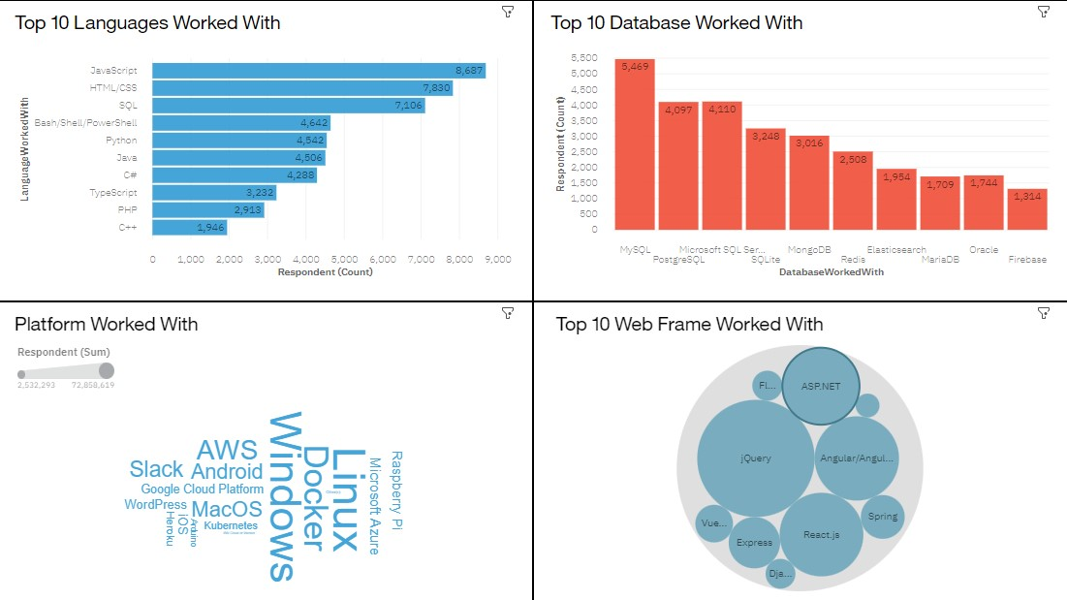
Current Technology Usage

Slide 13
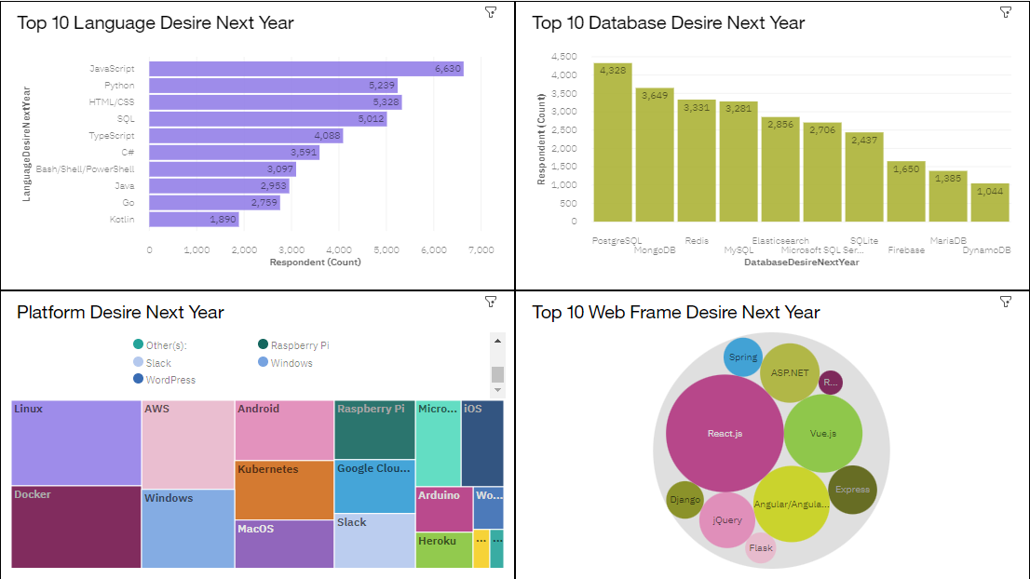
Future Technology Trends

Slide 14
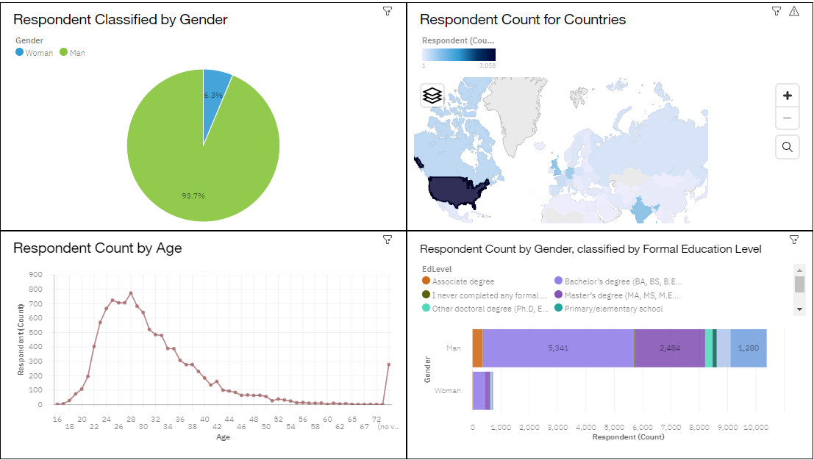
Demographics

Slide 15
DISCUSSION

Slide 16
OVERALL FINDINGS & IMPLICATIONS
Findings
Programming Languages: TypeScript is gaining significant interest and Python continues to grow as well
Databases: Redis, Elasticsearch, PostgreSQL and MongoDB are gaining more interest
Platforms: Interest in Slack is dropping significantly
Web Frames: Vue.js is gaining substantial interest and React.js continues to grow as well
Implications
Continue to staff enough JavaScript and HTML/CSS but employ more people skilled in TypeScript and Python
Employ more people skilled in Redis, Elasticsearch, PostgreSQL and MongoDB
Continue to staff enough Linux, employ more people skilled in Docker, AWS, and Android, but make reductions to Slack and Windows hiring

Slide 17

CONCLUSION
Plan for more budget in order to hire additional staff with skills needed to fill any gaps
Set aside budget or put a program in place to upskill those already employed
Make adjustments for staff with skills no longer in demand

Slide 18

APPENDIX

Slide 19
Job Postings by Language
In Module 1 you have collected the job posting data using Job API in a file named “job-postings.xlsx”. Present that data using a bar chart here. Order the bar chart in the descending order of the number of job postings.

Slide 20
Popular Languages by Average Annual Salary
In Module 1 you have collected the job postings data using web scraping in a file named “popular-languages.csv”. Present that data using a bar chart here. Order the bar chart in the descending order of salary.

